Slide 1
CRED Business Model
Analysis

Slide 2


About CRED
CRED is a Fintech platform headquartered in Bangalore, which allows its users to make credit card payments through its app and get exclusive offers. It was founded in April 2018 by Kunal Shah, Free charge's former founder. CRED lets us to handle and pay off all the credit card dues. It not only gives exclusive discounts on credit cards but also tracks expenses.
CRED provides the ability to reduce the pressure of handling multiple credit cards and to help pay card payments on a timely basis. Users earn points and CRED coins that can be used towards prompt purchases through the CRED application

Slide 3
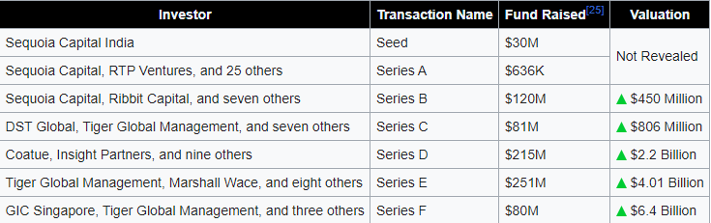
Customer Size & Investors
By 2022, the company had onboarded over 10 million users and processed about 20% of all credit card bill payments in India. As of April 2021, Cred offered six different products - Cred RentPay, Cred Cash, Cred Pay, Cred Store, and Cred Travel Store, etc. However, on 20 August 2021, Cred also launched a Peer to Peer(P2P) lending feature known as Cred Mint that aims to monetise through its 7.5 million users.

Slide 4
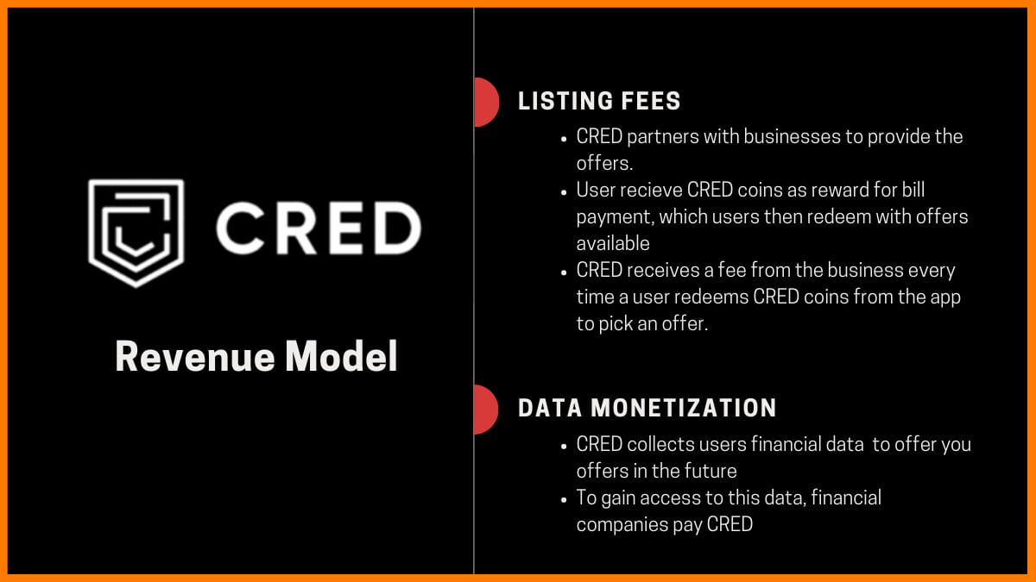
CRED Revenue Model

Slide 5
How does CRED make money ?
Earns money from the listing fees that businesses pay to display their products and offers on its app.
CRED receives a fee from the business every time a user redeems CRED coins from the app to pick an offer.
CRED collects the financial data as we use the app and continue to pay our bills to offer us a better offers in the future. This is their second source of income. Institutions are always searching for the most reliable customers to use their credit cards, loans and other products. To gain access to this data, banks and credit card companies pay CRED.

Slide 6



Service Analysis
CRED Pay was developed in partnership with Razorpay and Visa. It provides brands with a D2C channel by offering them an instant payment experience on their platforms.
CRED’s RentPay allows the us to pay monthly rents using a credit card. The main advantage that lies here is the app helps users to get an interest free credit period on rent and also lets them earn rewards.
CRED Store is a member exclusive selection of products and experiences at special prices. We can use our CRED coins to get special access to curated products and experiences here.
CRED Stash is a digital lending platform that makes a personal credit line and available to users in online. Here the registration is completely free excluding the bank charges on interest.

Slide 7
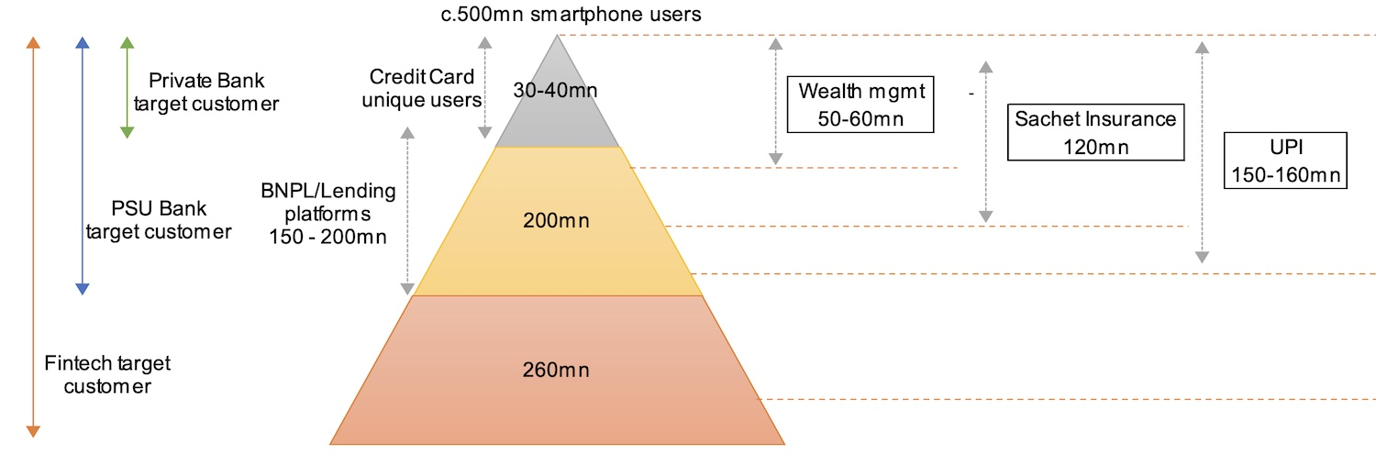
About Market
Key competitors in that period
Slice
OneCard
CreditVidya
Cred became the official sponsor for the Indian Premier League for three years from 2020 to 2022. In 2021, Cred's advertising content and videos, made in-house featuring Indian celebrities, generated significant discourse in news and social media due to its peculiarity, which was both criticized and praised.

Slide 8
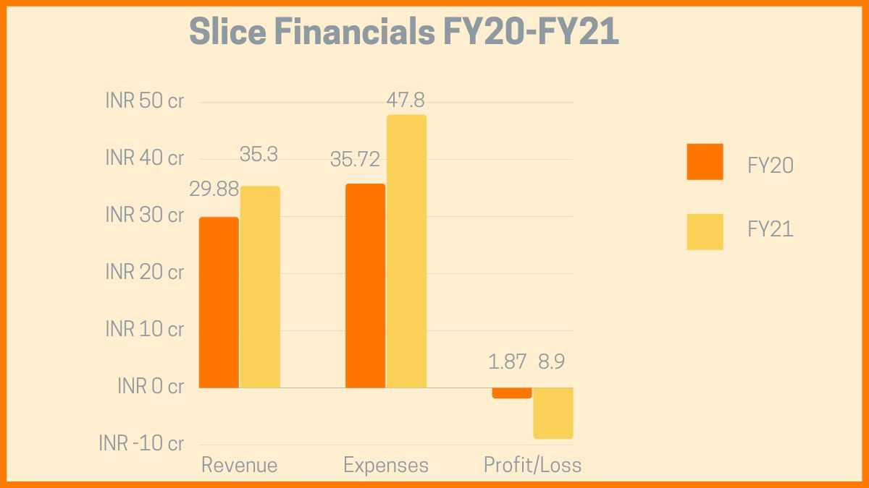
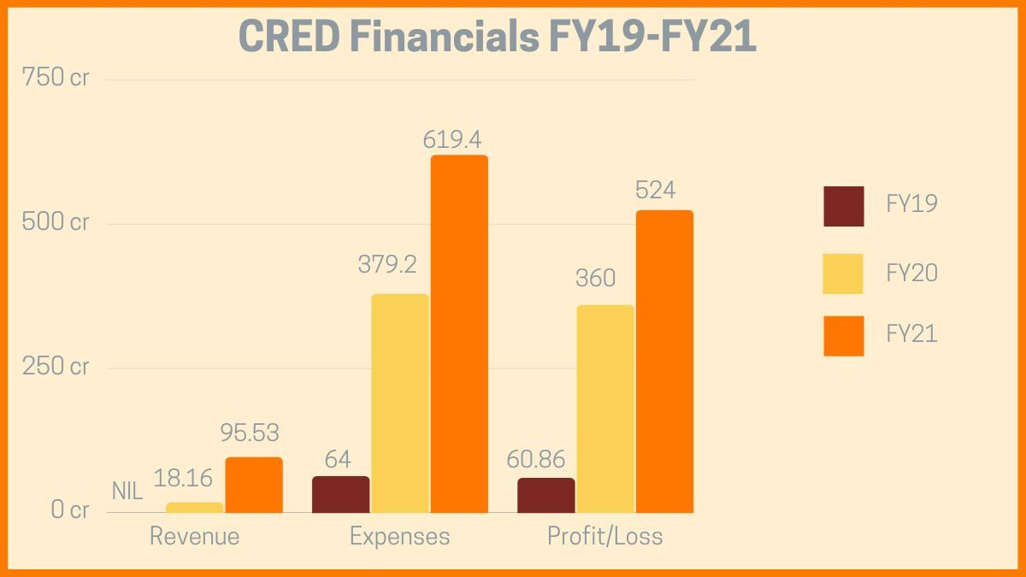
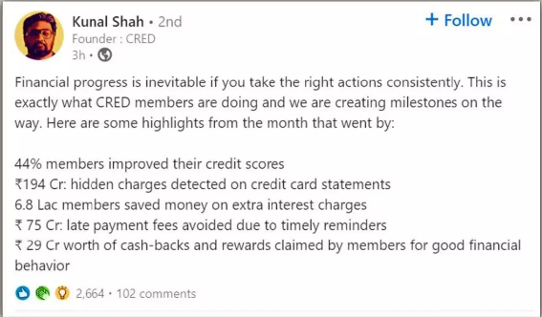
Position of CRED in the Market

Slide 9
Socioeconomic Factors Faced by CRED
In 2018 the percentage of credit card users in India were very less. It belongs to that 5 to 10 % of the rich population. As a result it became difficult to make a good amount of profit from India.
CRED posted losses of Rs 360.31 CR in the year 2020, caused primarily due to high expenditure on marketing and advertising.
CRED is a 2 – 3 year old platform which make it new startup for new things, “trust and relevance of the customers” is one of the major challenges faced.
Credit card payment platform Cred, owned and operated by Dreamplug Technologies Pvt Ltd, reported a 45% increase in its net loss for 2020-21 (FY21) as the company’s marketing expenses soared manifold during the year, according to an official document shared by the company.

Slide 10
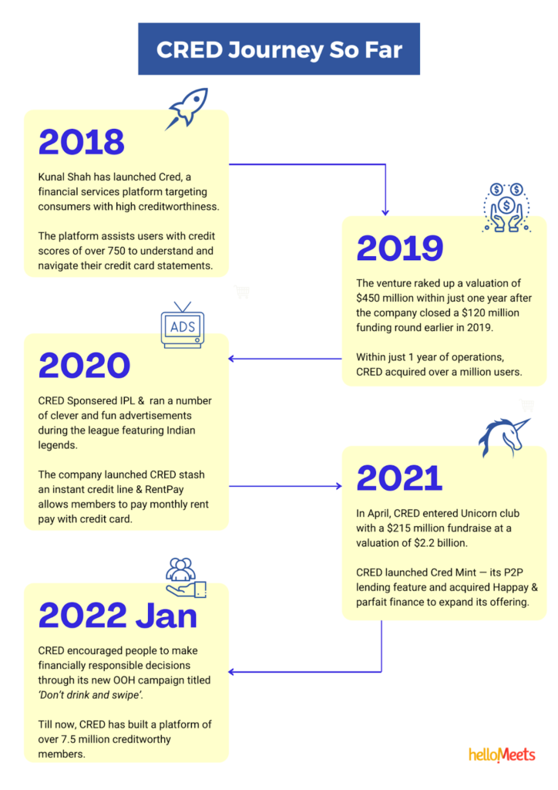
PR & Media
CRED gained popularity through media and PR.
CRED posted many video adds, news and public posts in social media to reach out to people.
As a result when people came to know about the rewards and the cashback, automatically it became habituated for the credit card users to use this app and pay the bills.
In addition to handling media requests, information queries, and shareholder concerns, PR personnel are frequently responsible for crafting and maintaining the corporation's image. CRED took this advantage..
Product Relations, Invertors Relations, Community Relation, Government Relation etc..

Slide 11
Failure Cause & Effect Analysis
Competitor in market
UPI - The main cause of failure of CRED is UPI which had the scan and pay feature. So after the guidelines of RBI all the phone numbers are linked with the bank accounts. UPI takes advantage of this. People started using UPI for paying all the credit card payments and the loan payments.
Paytm – It is the top competitor of CRED.
Phone Pay – Phone Pay is also an another notable competitor of CRED. This app has the largest market share of 55.56 % as of December 2022.
MobiKwik – It is yet another fintech company which supports digital payment options and is a rival of CRED at the same time. They were race against one another.

Slide 12
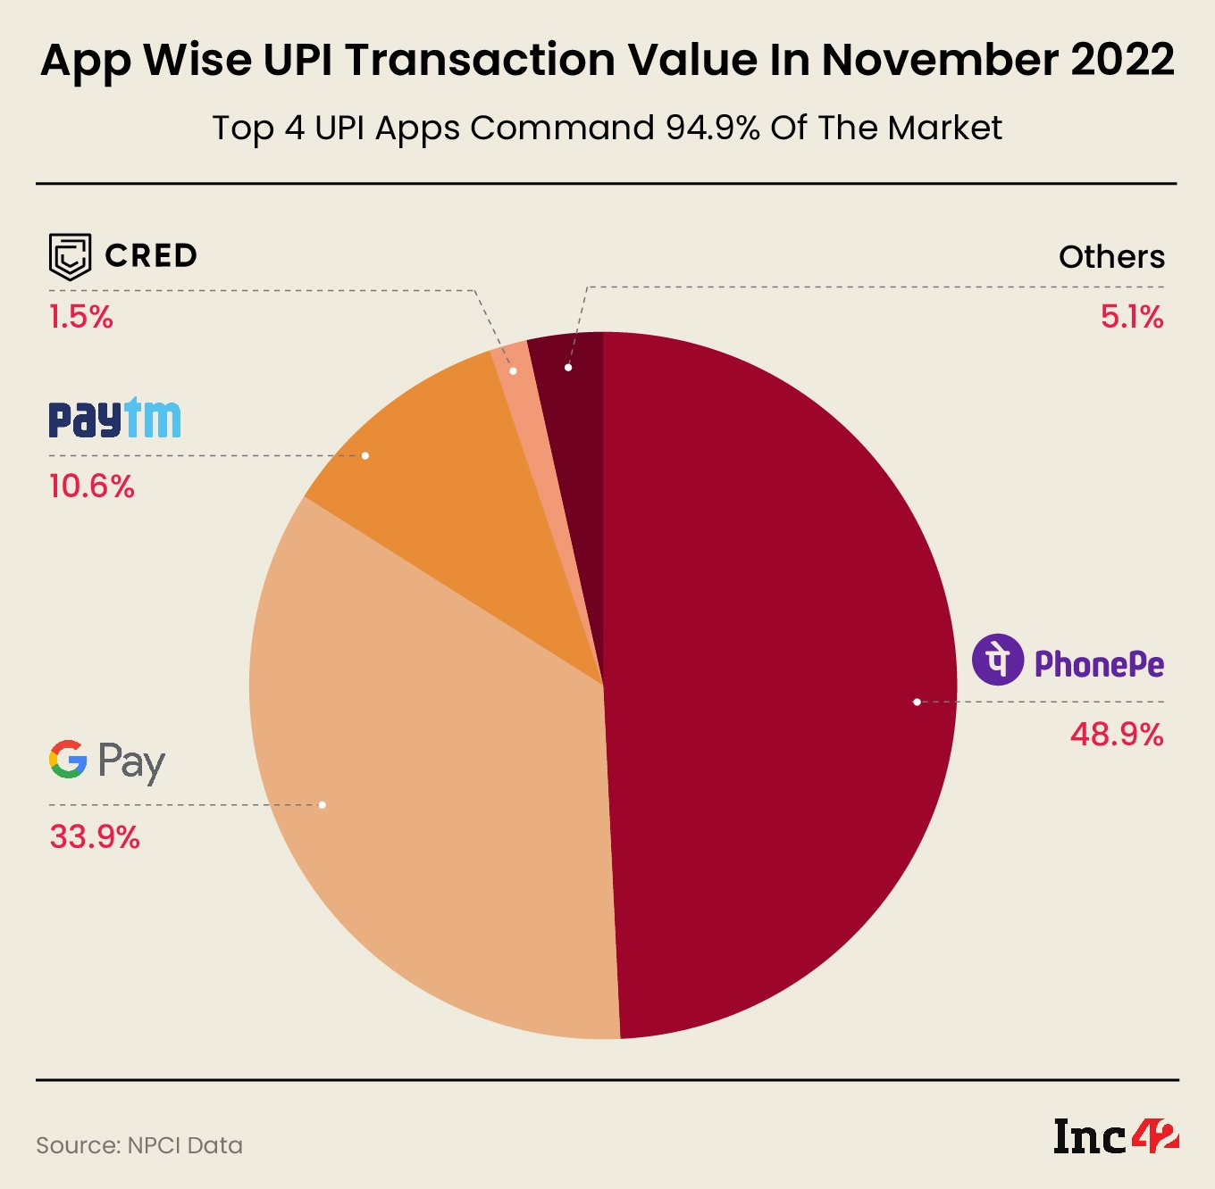

Slide 13
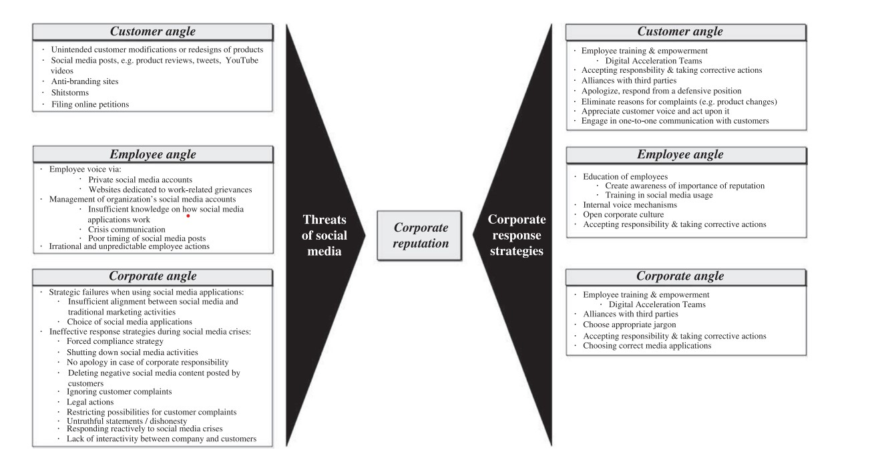
PR or Media Reputation Damage

Slide 14
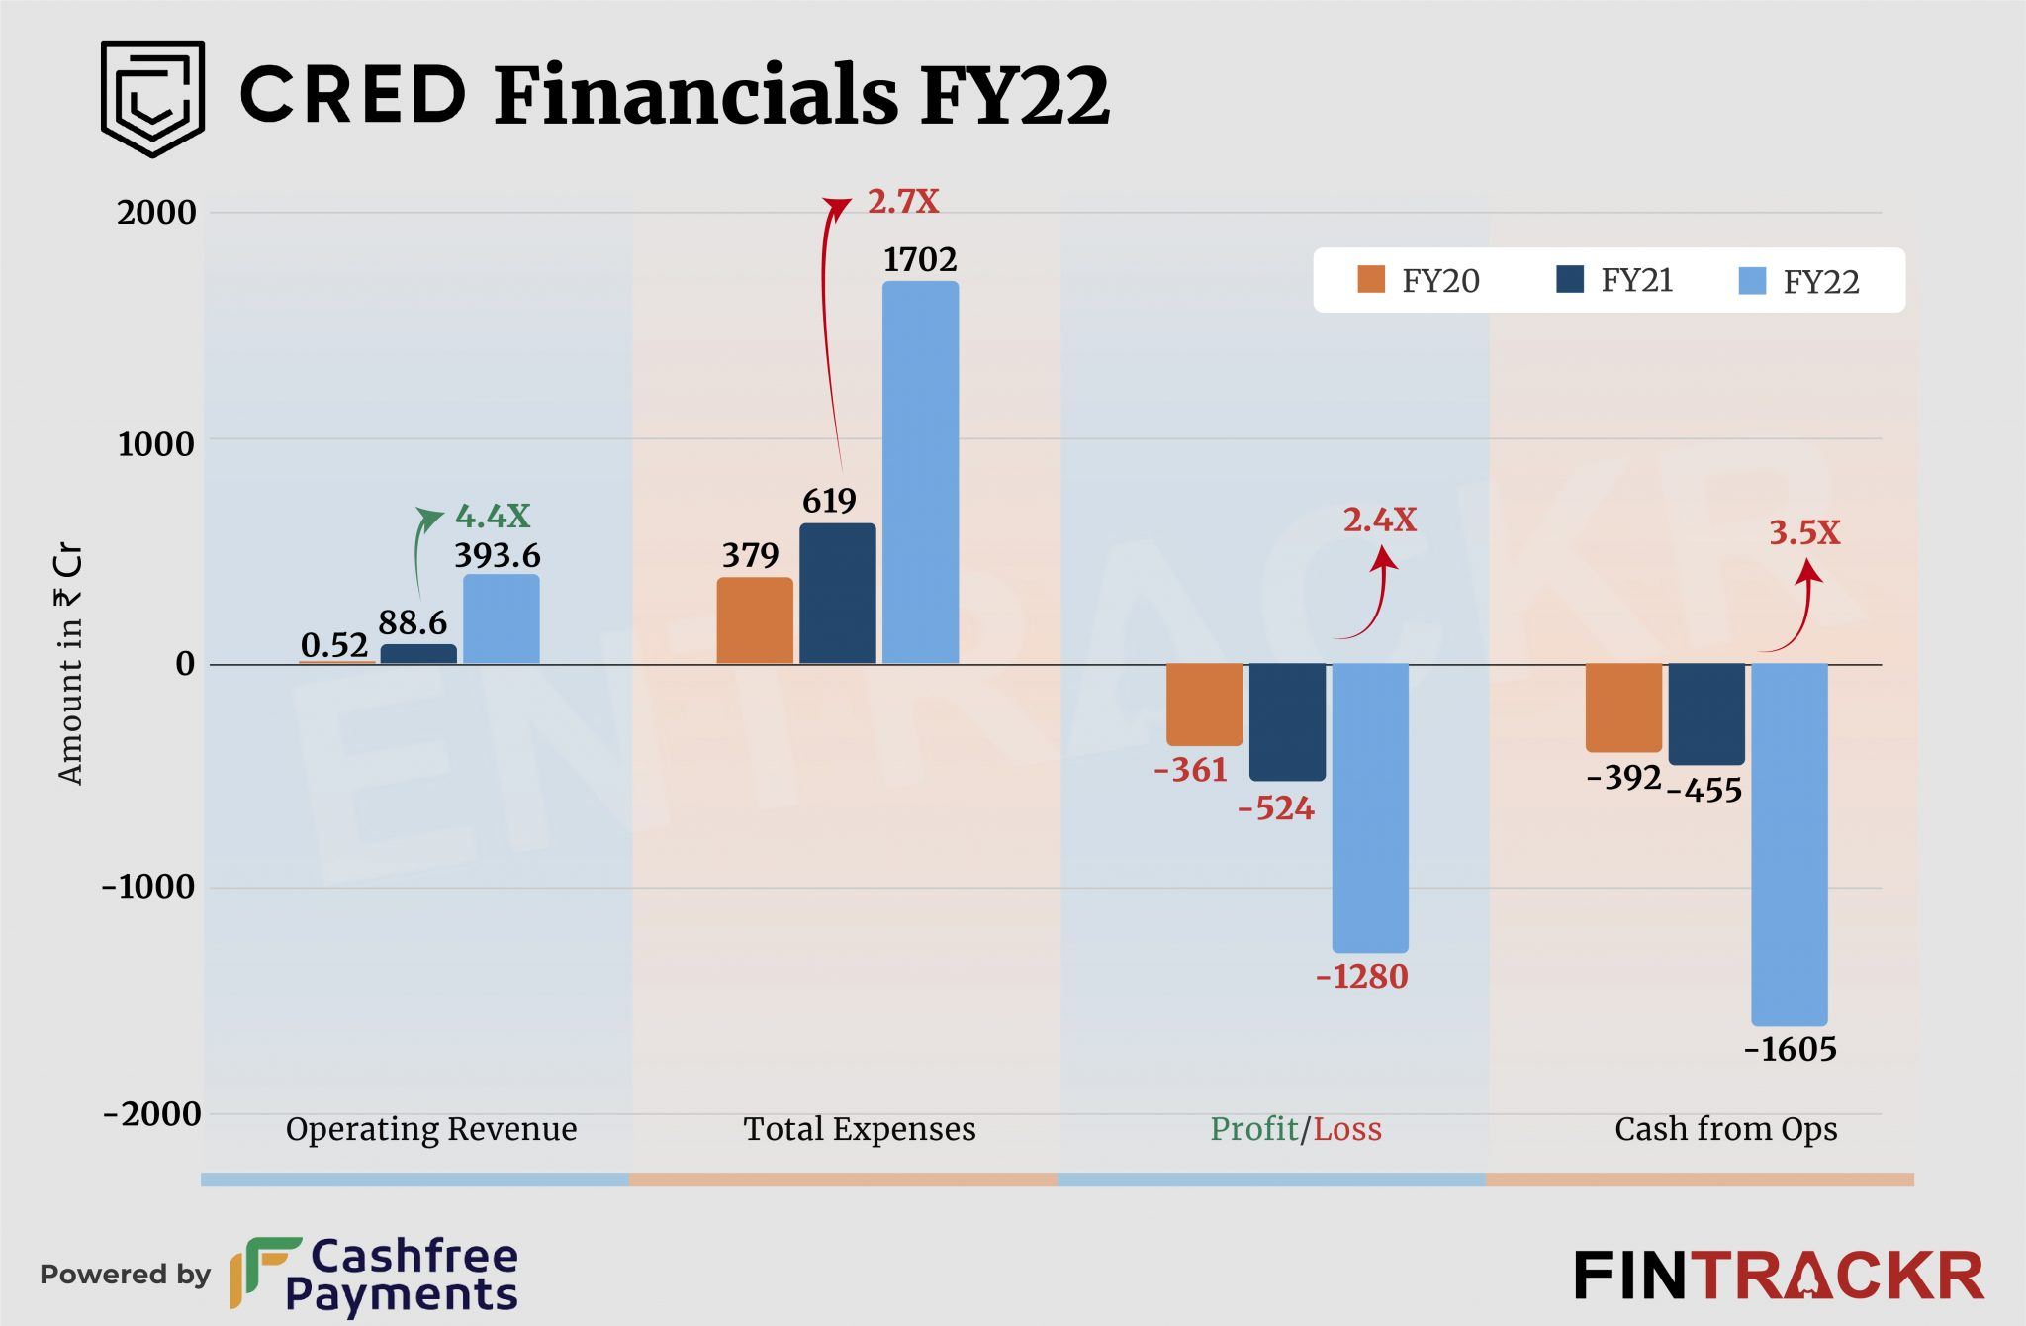
Growth Opportunities & Current Scenario

Slide 15
Entry to New Market & Product Opportunities
Cred introduced near-field communication (NFC)-based payments through ‘Tap to Pay'. The fintech platform also unveiled its buy-now-pay-later offering, Cred Flash. According to Cred, ‘Tap to Pay’ uses secure card tokenisation technology to store card tokens on the device. When members tap their phone on a card reader, this token data is transferred via NFC to the reader to initiate a payment, making transactions safe and secure.
Cred also announced its entry into the buy-now-pay-later (BNPL) space with Cred Flash. Cred Flash will be powered by Parfait Finance and Investments Pvt Limited, a non-banking finance company (NBFC) which was acquired by Cred founder Kunal Shah in November 2021.
CRED launched a peer-to-peer (P2P) lending product called CRED Mint for its users.
CRED Mint is the company’s first community-driven product that enables members to earn interest
on idle money by lending to other members. The fintech firm has partnered with Liquiloans, an RBI-
registered P2P NBFC for the new product.
CRED said that those members who participate in CRED Mint can earn inflation-beating interest rates of up to 9 per cent per annum, higher than traditional methods.

Slide 16
What could go Wrong in Future ?
If the marketing , promotion expenses continues with the current rate regardless of continuous losses, company may result in more losses which may damage the trust investors have shown.
Most of the credit card bill payments are done in the month’s ending in case of any technical discrepancy during that time may lead to failure of payments as a result of which customers will be imposed penalties by bank . This may affect the customer base largely so, this needs to be ensured that no technical problems arises.
Rewards should be competitive . If any competitor provides better offers and rewards this may also attract customer base and affect users of cred.

Slide 17
THANK YOU

